Slide 1
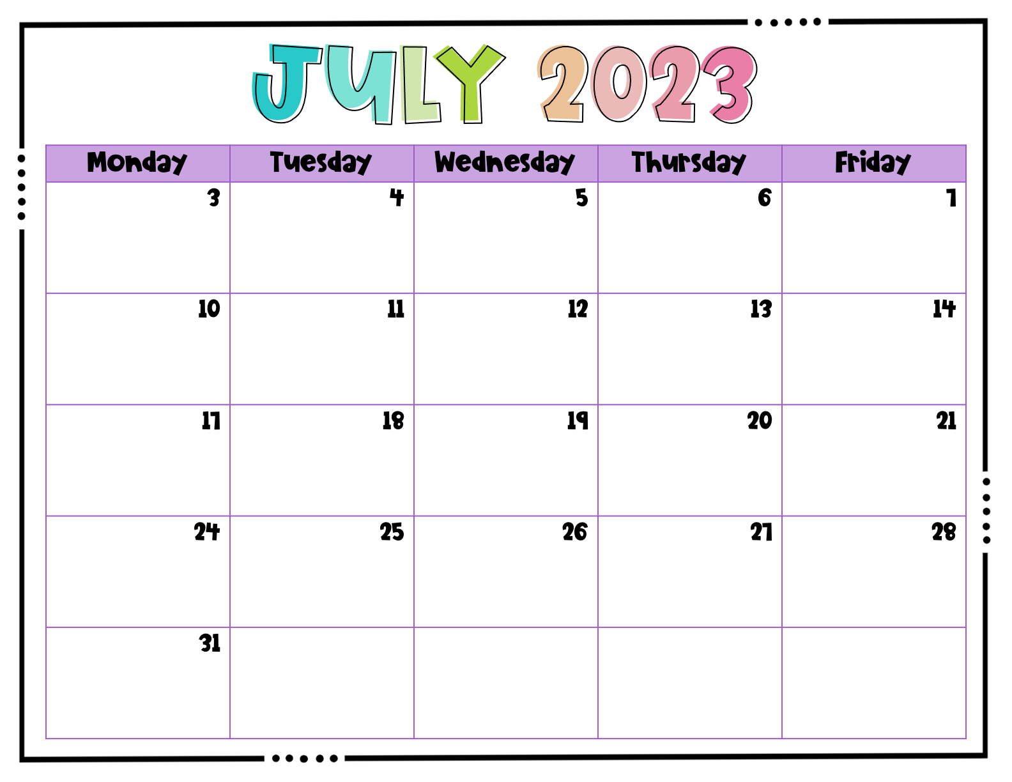
 |  | Parent Pop In 4-6pm | Students first day of school.

Slide 2
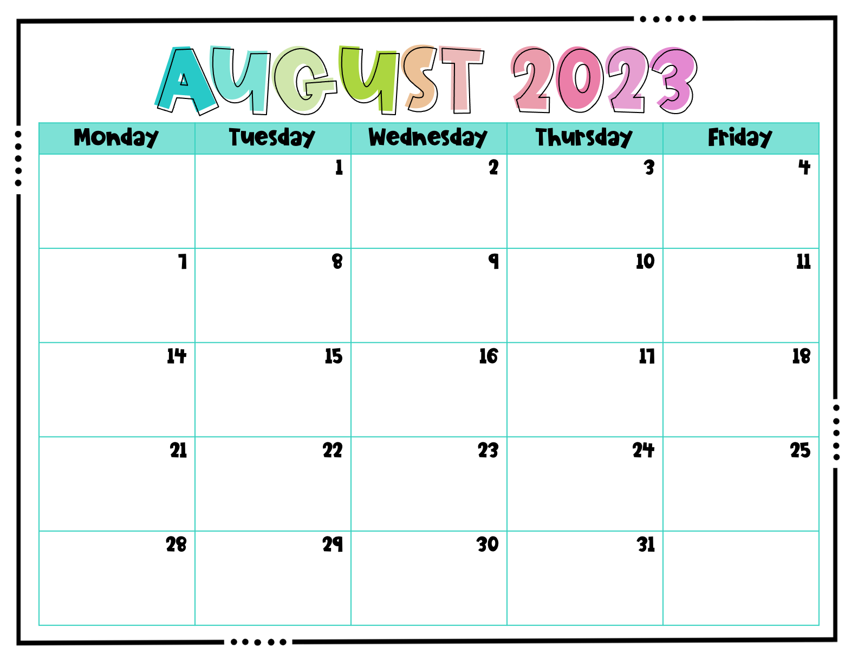
 |  |  |  | Lockdown Drill
 |  |  |  | Fire Drill Kona Ice PBIS Kick off
 | Meet the Author @ Joe Cook 1st-2nd Grade

Slide 3
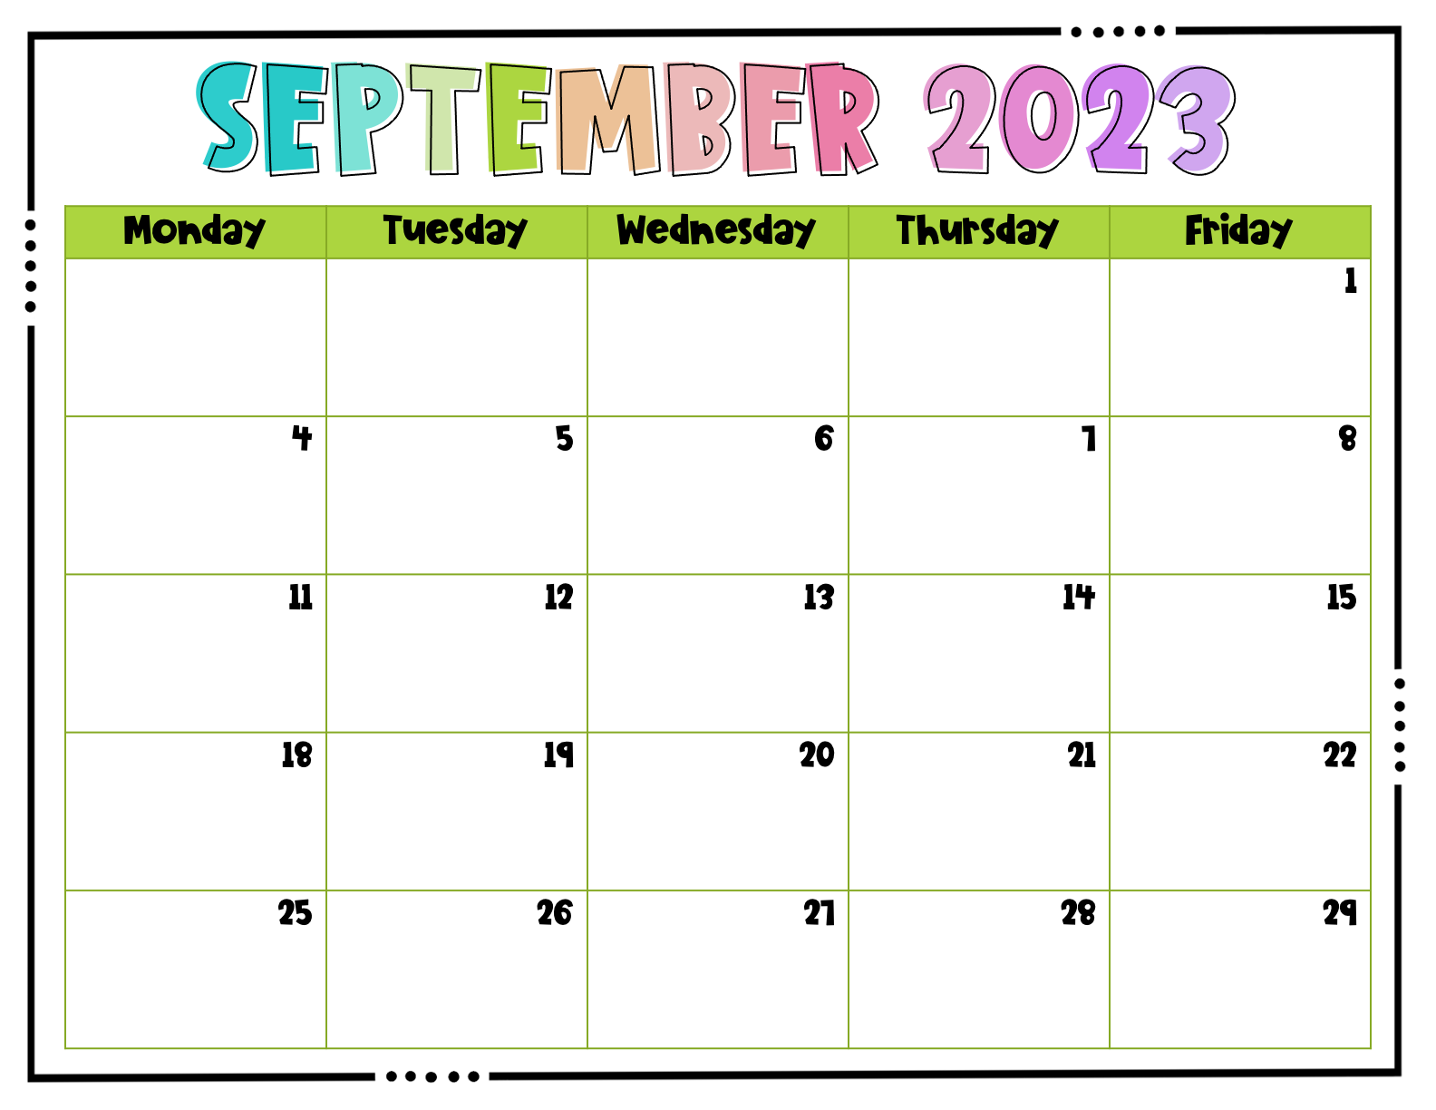
 |  |  |  | Grab-A-Day Fundraiser begins. Memphis Zoo Trip
School Holiday |  |  |  | Fire Drill
Homecoming Week | Homecoming Week |  | Skate Zone Homecoming Week | Kona Ice 11am-1pm Mcwane 3rd-4th
 |  |  |  | Grab-A-Day Fundraiser ends. Mcwane on the Move 1st-2nd

Slide 4
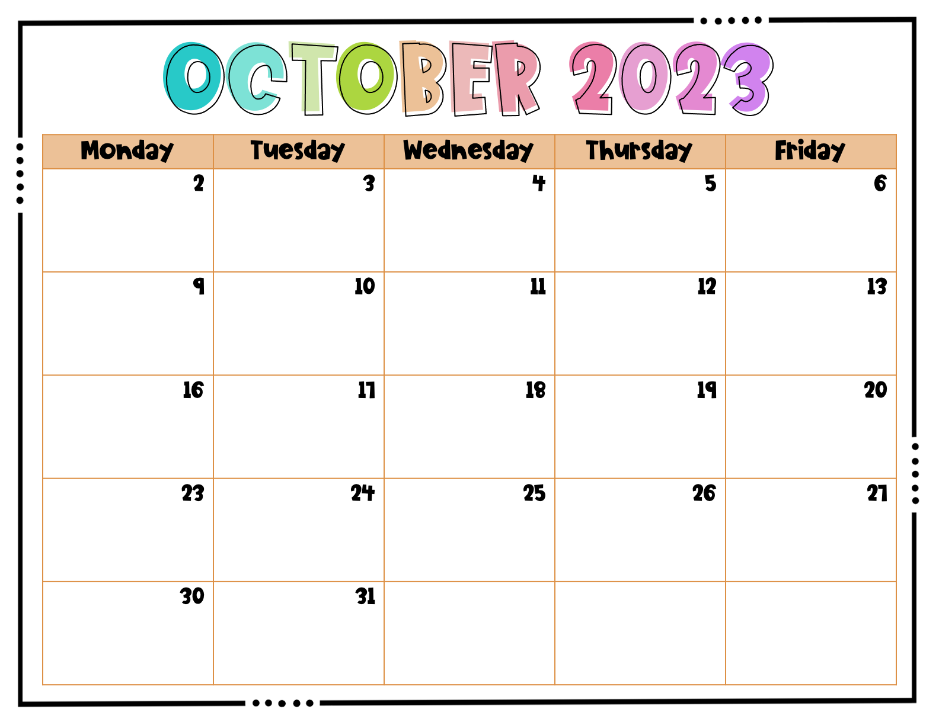
Intersession | Intersession | Intersession | Intersession | Intersession Fire Drill
Fall Break | Fall Break |  | Fall Break | Fall Break
 |  |  | Kona Ice ?? | Mcwane on the Move 1st-2nd Kona Ice ??
Fall Festival Ticket Sale Starts Red Ribbon Week | Ticket Sale Red Ribbon Week | Ticket Sale Red Ribbon Week | Ticket Sale Ends Fall Festival 4pm-6pmRed Ribbon Week | Red Ribbon Week

Slide 5
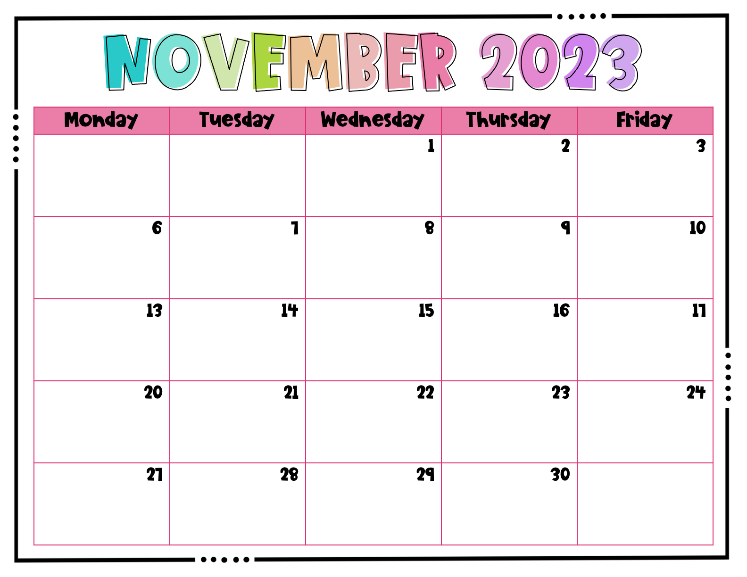
 |  |  |  | Tornado Drill
 |  |  |  | McWane on the move Prek-k Fire Drill
Thanksgiving Break | Thanksgiving Break |  | Thanksgiving Break | Thanksgiving Break

Slide 6
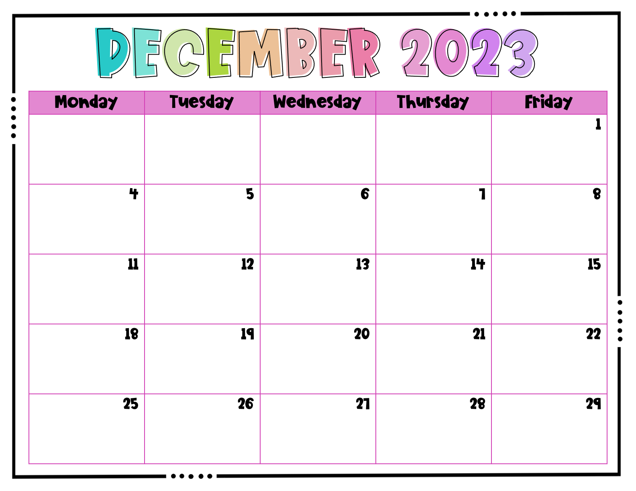
 |  |  |  | Mcwane on the move 4th-5th Fire Drill
 |  |  |  | Earthquake drill
 |  |  |  | 60% Day
Christmas Break | Christmas Break |  | Christmas Break | Christmas Break

Slide 7
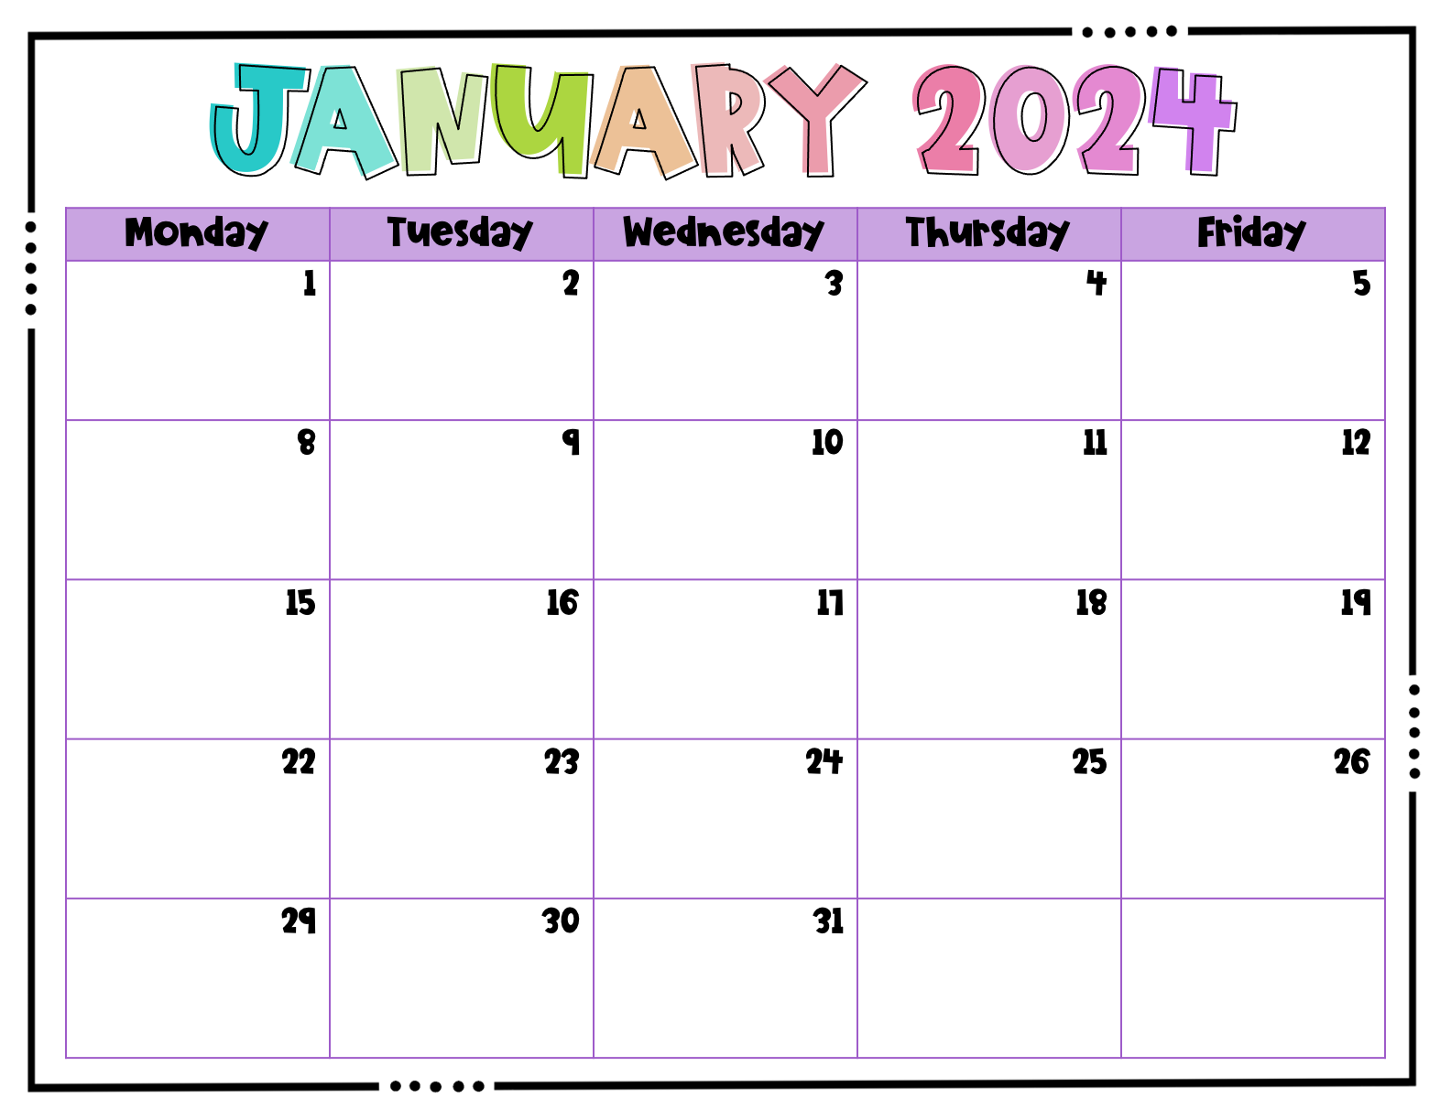
Christmas Break | Christmas Break |  |  | Fire Drill
 |  |  |  | Mcwane on the Move 4th-5th
School Holiday |  |  |  | 100th Day of School

Slide 8
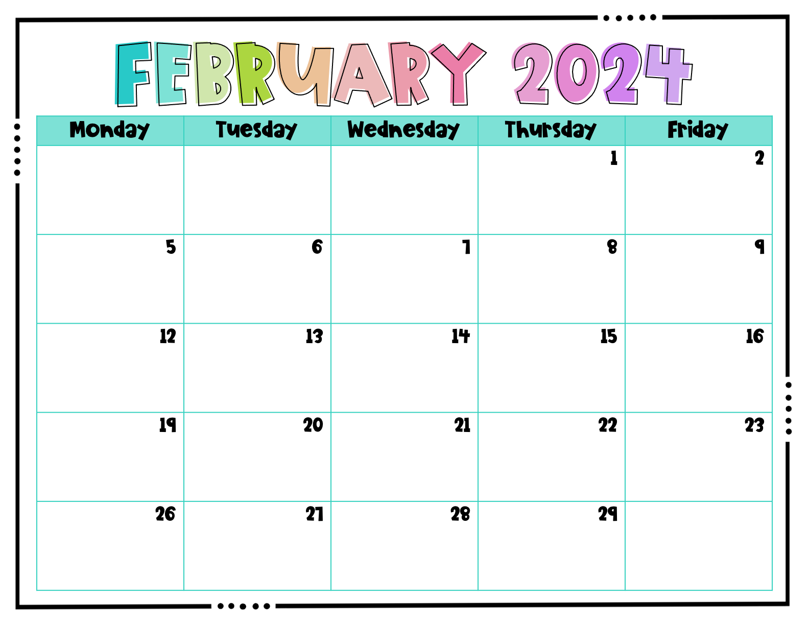
 |  |  |  | McWane on the move Prek-K Tornado Drill
 |  |  |  | Fire Drill
Presidents’ Day/Teacher Workday |  |  |  | Mcwane on the move 1st-5th Assembly

Slide 9
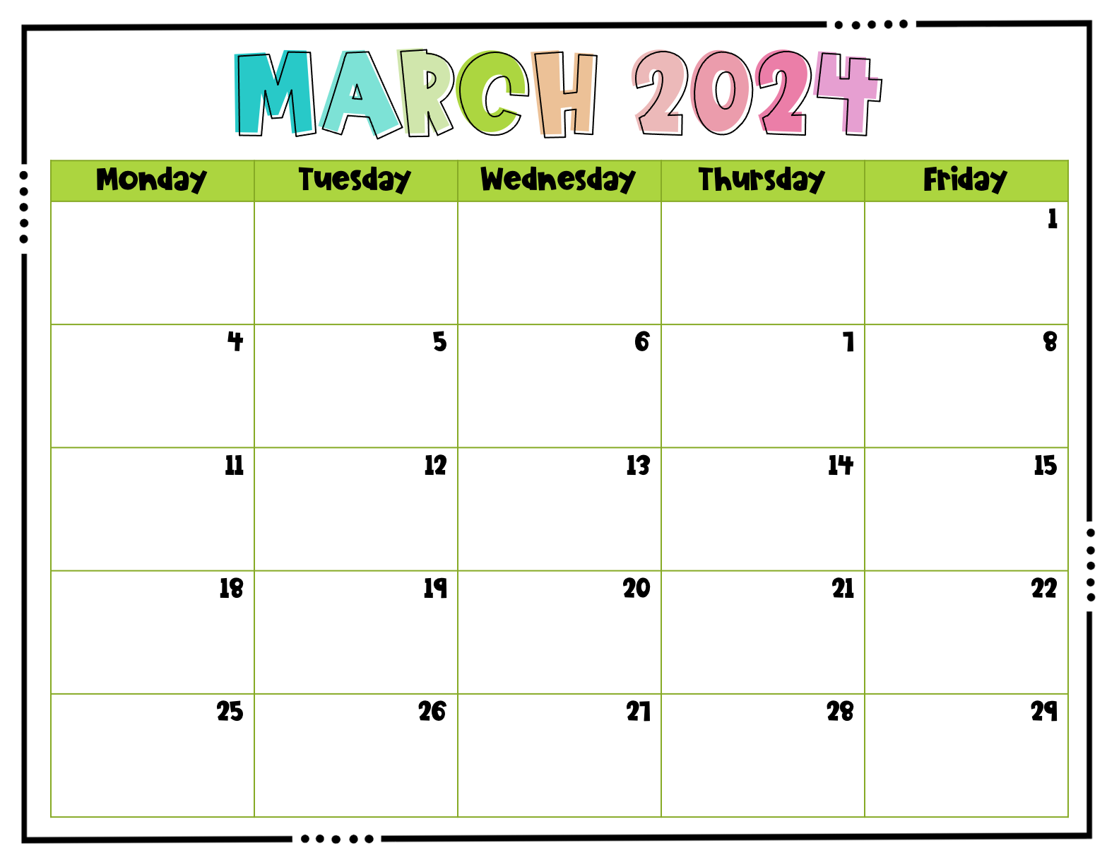
 |  |  |  | Mcwane on the move 3rd & 5th
 |  |  |  | Fire Drill
 |  |  |  | Lockdown Drill
Intersession | Intersession | Intersession | Intersession | Intersession
Spring Break | Spring Break |  | Spring Break | Spring Break

Slide 10
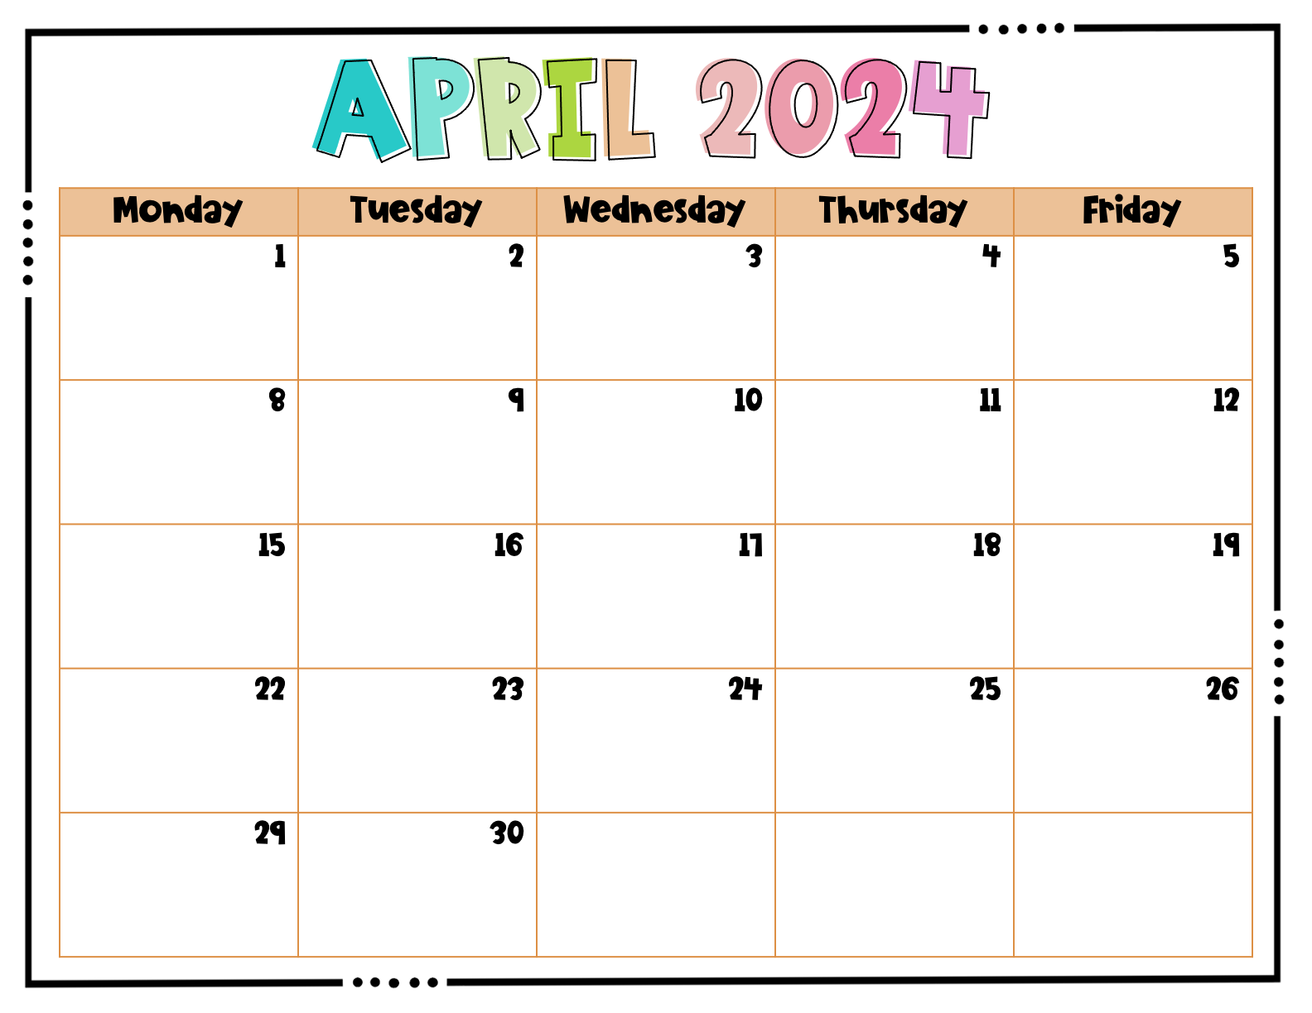
 |  |  | Bomb Threat Drill | Fire Drill
 |  |  |  | Tornado Drill

Slide 11
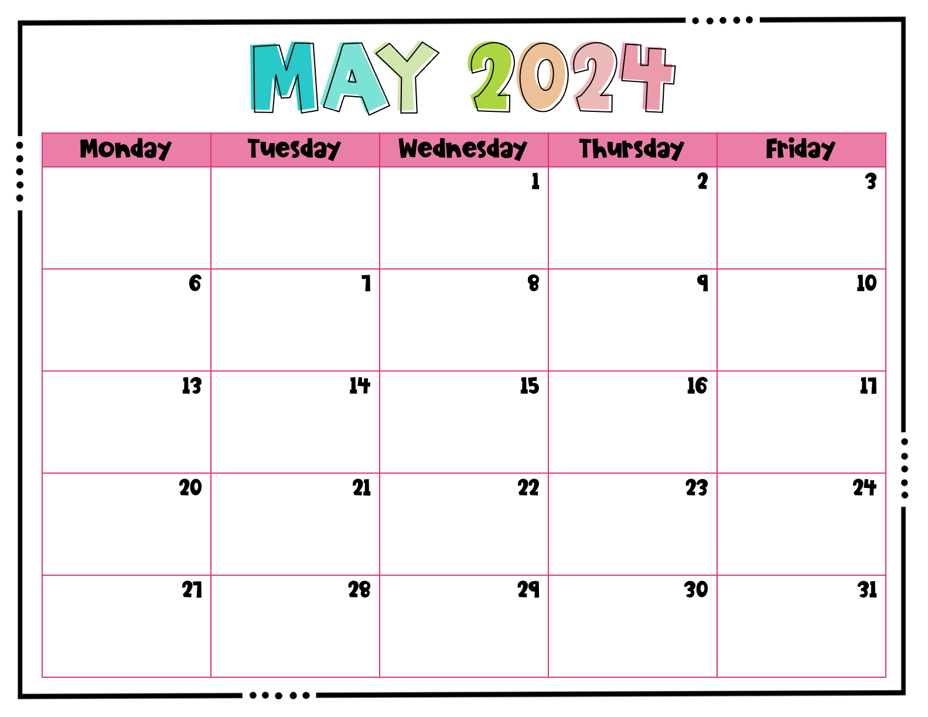
 |  | Earthquake Drill |  | Fire Drill

Slide 12
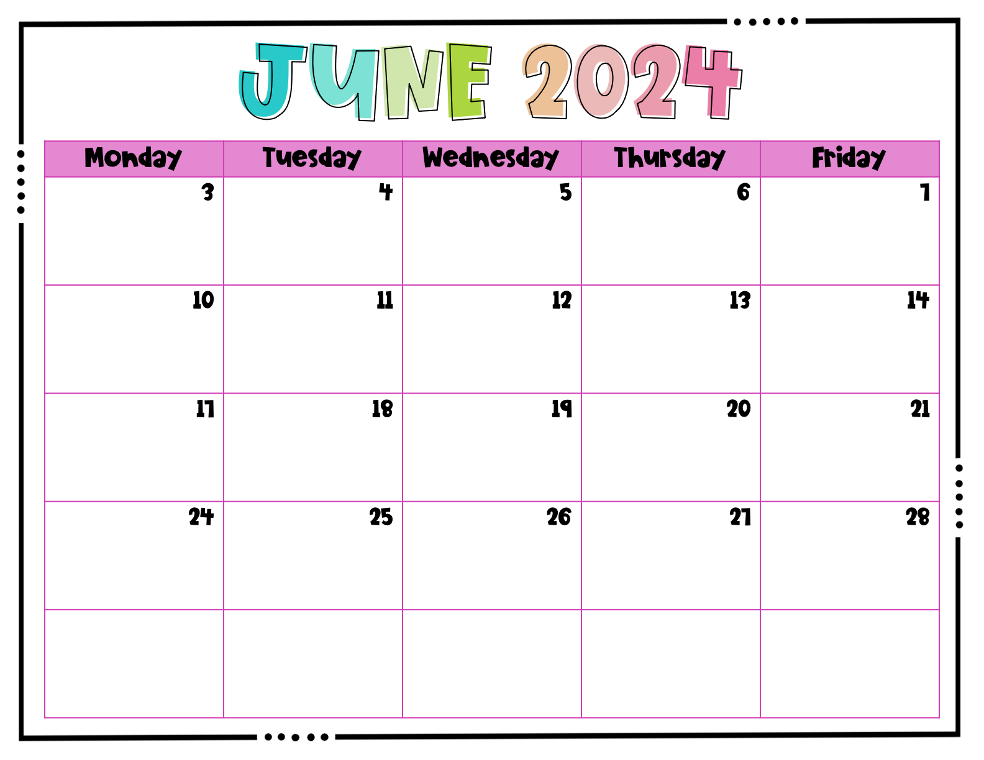

Slide 13
